Slide 1

Session No.: 1 Course Name: Aptitude proficiency Course Code: R1UC425L Instructor Name: Ashish kumar Duration: 50 Mins Date of Conduction of Class: 16/02/2026
Notes:
1

Slide 2
Learning Outcome 1:Understand the concepts of ratio and proportion, and apply them to compare quantities effectively.
Learning Outcome 2: Solve problems based on direct and inverse proportions in real-life and aptitude scenarios.

Slide 3
Session Outline
1 Quick “Think Pair Share” on prior knowledge.
2 Brainstorm real life example.
3 Group work on Ratio, Proportion & Variation, Partnership
4 Solve & discuss word problem on Permutation and Combination
5 Summarize key takeaways.
6 Reinforce learning with quick recap.

Slide 4
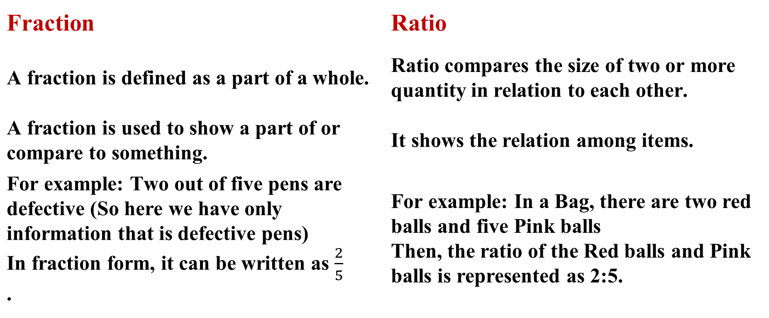
Difference between Fraction and Ratio
Fraction | Ratio
A fraction is defined as a part of a whole. | Ratio compares the size of two or more quantity in relation to each other.
A fraction is used to show a part of or compare to something. | It shows the relation among items.
For example: Two out of five pens are defective (So here we have only information that is defective pens) In fraction form, it can be written as $\frac{2}{5}$ . | For example: In a Bag, there are two red balls and five Pink balls Then, the ratio of the Red balls and Pink balls is represented as 2:5.

Slide 5
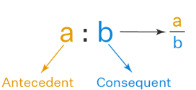
RATIO:
When two or more similar quantities are compared, then to represent this comparison, ratios are used.
The sign used to denote a ratio is ‘:’
A fraction can be represented in the form of ratio a:b and vice versa.
The ratio should exist between the quantities of the same kind
While comparing two things, the units should be similar
The comparison of two ratios can be performed, if the ratios are equivalent like the fractions

Slide 6
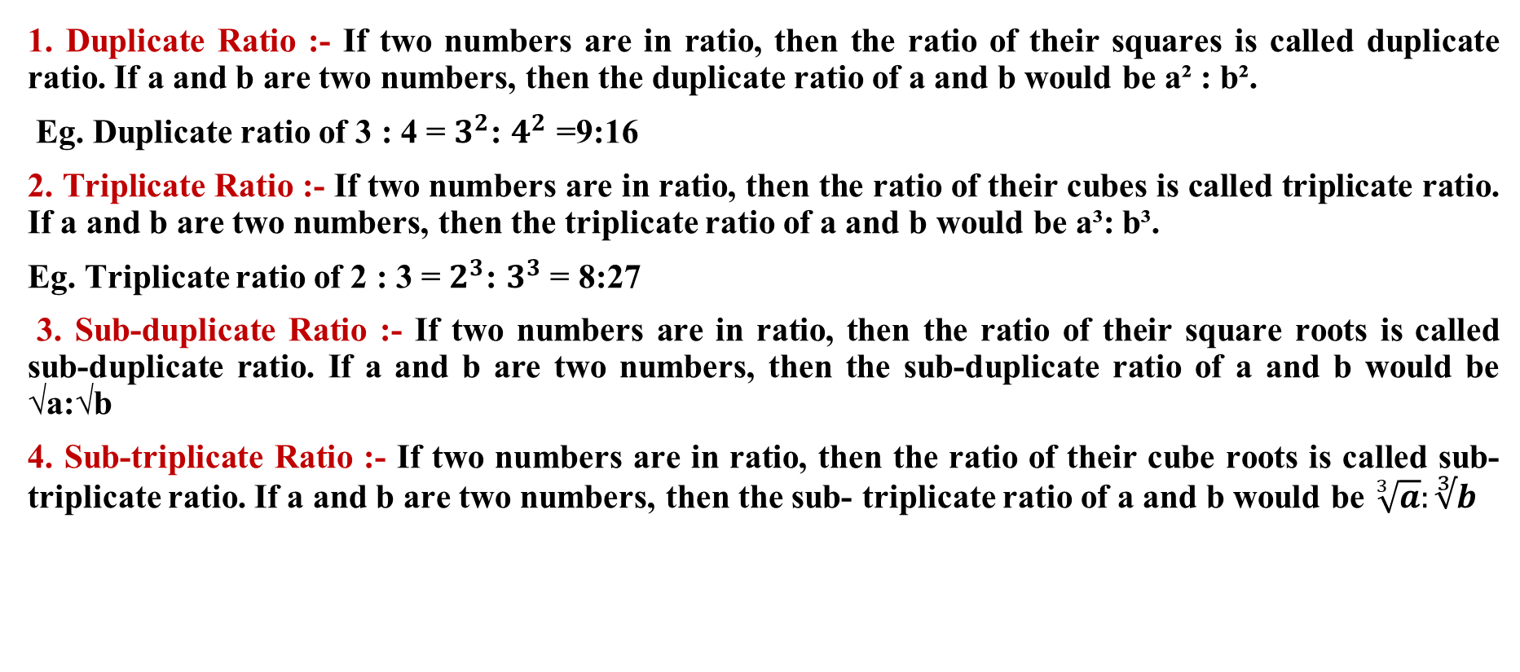
Types of ratios:
1. Duplicate Ratio :- If two numbers are in ratio, then the ratio of their squares is called duplicate ratio. If a and b are two numbers, then the duplicate ratio of a and b would be a² : b².
Eg. Duplicate ratio of 3 : 4 = $3^{2}$: $4^{2}$ =9:16
2. Triplicate Ratio :- If two numbers are in ratio, then the ratio of their cubes is called triplicate ratio. If a and b are two numbers, then the triplicate ratio of a and b would be a³: b³.
Eg. Triplicate ratio of 2 : 3 = $2^{3}$: $3^{3}$= 8:27
3. Sub-duplicate Ratio :- If two numbers are in ratio, then the ratio of their square roots is called sub-duplicate ratio. If a and b are two numbers, then the sub-duplicate ratio of a and b would be √a:√b
4. Sub-triplicate Ratio :- If two numbers are in ratio, then the ratio of their cube roots is called sub-triplicate ratio. If a and b are two numbers, then the sub- triplicate ratio of a and b would be $\sqrt[3]{a}:∛b$

Slide 7
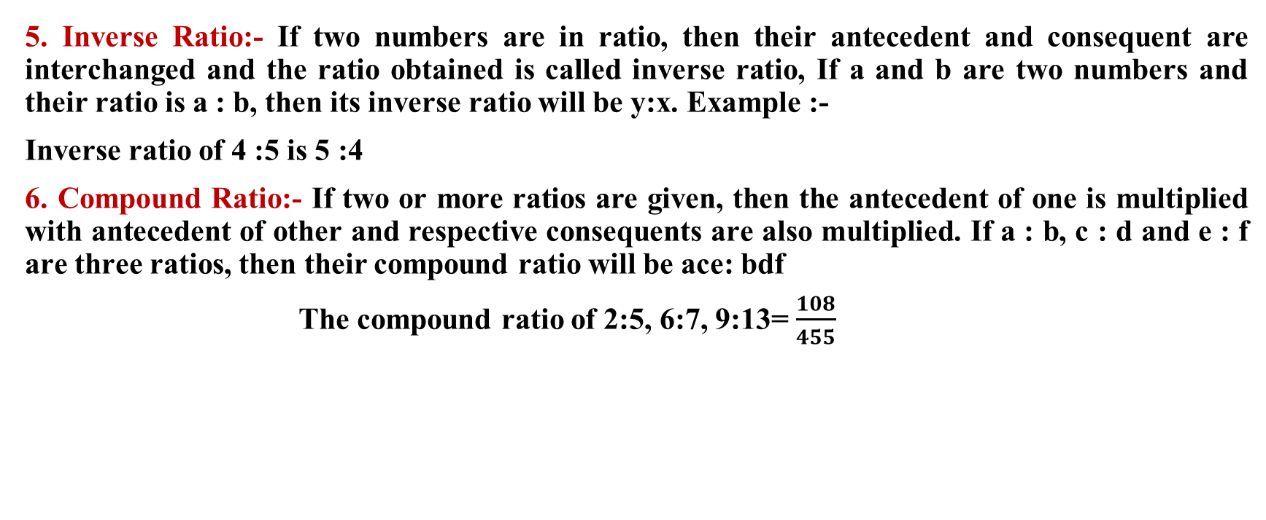
5. Inverse Ratio:- If two numbers are in ratio, then their antecedent and consequent are interchanged and the ratio obtained is called inverse ratio, If a and b are two numbers and their ratio is a : b, then its inverse ratio will be y:x. Example :-
Inverse ratio of 4 :5 is 5 :4
6. Compound Ratio:- If two or more ratios are given, then the antecedent of one is multiplied with antecedent of other and respective consequents are also multiplied. If a : b, c : d and e : f are three ratios, then their compound ratio will be ace: bdf
The compound ratio of 2:5, 6:7, 9:13= $\frac{108}{455}$

Slide 8
1. If a:b=2:3 and b:c=2:4 then a:b:c=?
A. 2:3:6
B. 2:4:8
C. 1:3:8
D. 4:9:12
Notes:
Answer- A
8

Slide 9
2. The compounded ratio of (2 : 3), (6: 11) and (11 :2) is
1:2
2:1
11:24
36:121
Notes:
Answer- B (Easy)
Compounded Ratio :: When we compound two or more ratio's with each other through product or multiplication, the result is simply a compound ratio.
Thus, the product of two or more ratios; i.e, ab:cd is a ratio compounded of the simple ratios a:c and b:d.
Required compounded ratio = (2/3 x 6/11 x 11/2) = 2/1.
9

Slide 10
3. If a:b:c=2:3:4 and 2a-3b+4c=33, then the value of c is.
A. 6
B. 8
C. 9
D. 12
Notes:
Answer- D
10

Slide 11
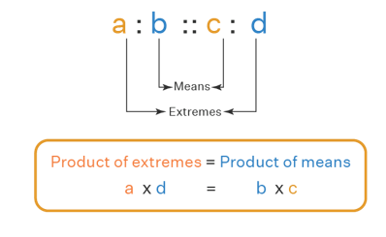
PROPORTION:-
Proportion is an equation that defines that the two given ratios are equivalent to each other.
When two ratios are equal in value, then they are said to be in proportion. In simple words, it compares two ratios. Proportions are denoted by the symbol ‘::’ or ‘=’

Slide 12
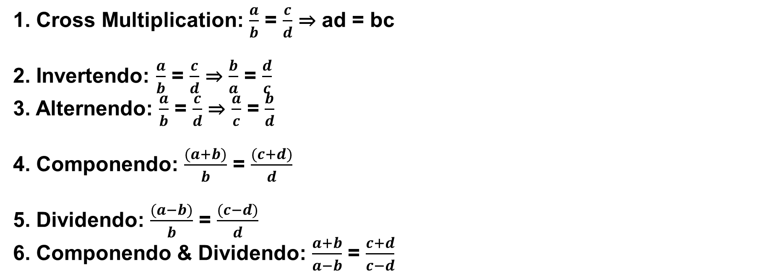
1. Cross Multiplication: $\frac{a}{b}$ = $\frac{c}{d}$ ⇒ ad = bc
2. Invertendo: $\frac{a}{b}$ = $\frac{c}{d}$ ⇒ $\frac{b}{a}$ = $\frac{d}{c}$
3. Alternendo: $\frac{a}{b}$ = $\frac{c}{d}$ ⇒ $\frac{a}{c}$ = $\frac{b}{d}$
4. Componendo: $\frac{(a+b)}{b}$ = $\frac{(c+d)}{d}$
5. Dividendo: $\frac{(a−b)}{b}$ = $\frac{(c−d)}{d}$
6. Componendo & Dividendo: $\frac{a+b}{a−b}$ = $\frac{c+d}{c−d}$

Slide 13
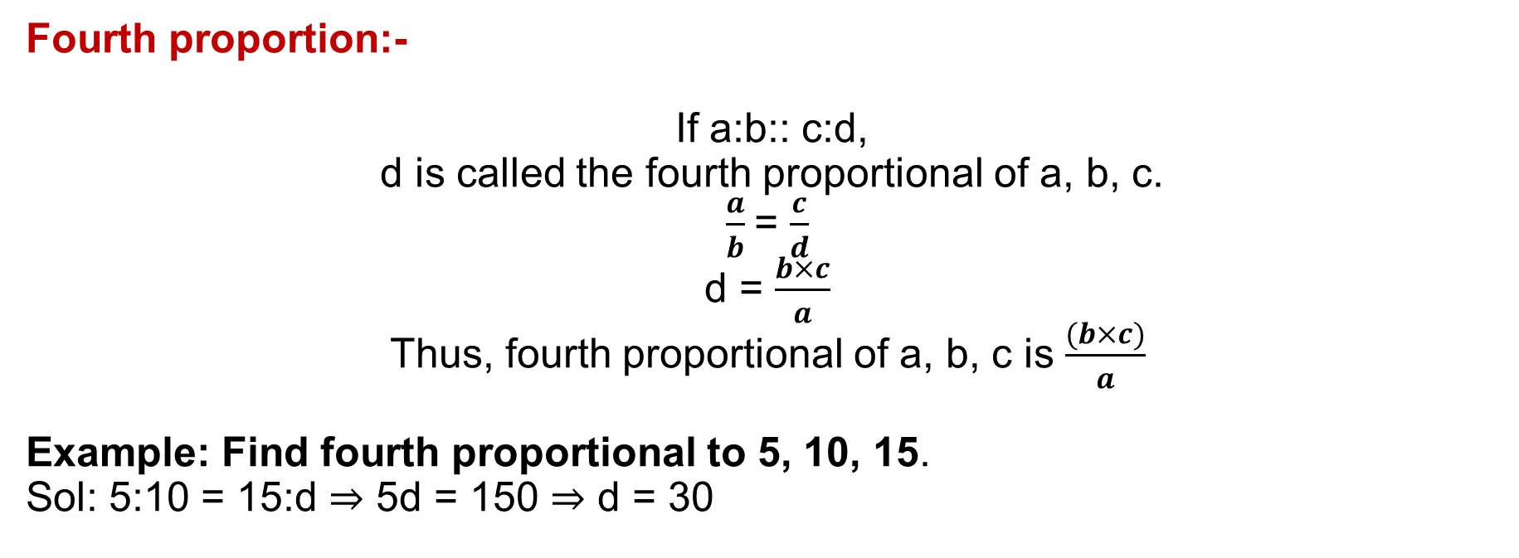
Fourth proportion:-
If a:b:: c:d,
d is called the fourth proportional of a, b, c.
$\frac{a}{b}$= $\frac{c}{d}$
d = $\frac{b×c}{a}$
Thus, fourth proportional of a, b, c is $\frac{(b×c)}{a}$
Example: Find fourth proportional to 5, 10, 15.
Sol: 5:10 = 15:d ⇒ 5d = 150 ⇒ d = 30

Slide 14
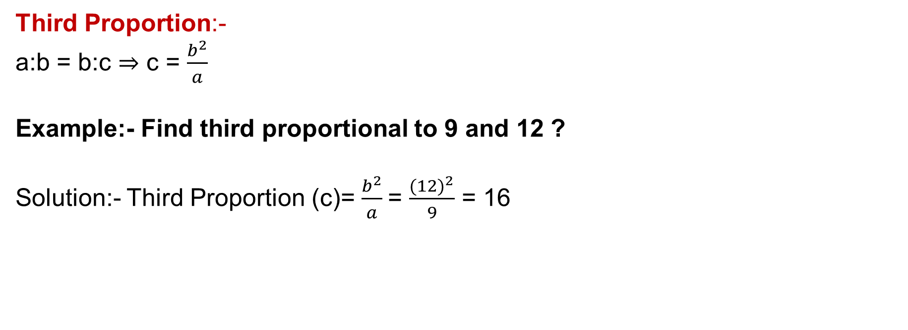
Third Proportion:-
a:b = b:c ⇒ c = $\frac{b^{2}}{a}$
Example:- Find third proportional to 9 and 12 ?
Solution:- Third Proportion (c)= $\frac{b^{2}}{a}$= $\frac{{(12)}^{2}}{9}$ = 16

Slide 15
Mean Proportional:-
Mean Proportional (b) between a and c:- b = √(ac)
Example: Find mean proportion between 4 and 9 ?
⇒ √(4×9) = 6

Slide 16
4. The fourth proportional to 5, 8, 15 is:
A. 18
B. 24
C. 19
D. 20
Notes:
Answer- B(Easy)
Let the fourth proportional to 5, 8, 15 be x.
Then, 5 : 8 : 15 : x
5x = (8 x 15)
x =(8 x 15) /5= 24
16

Slide 17
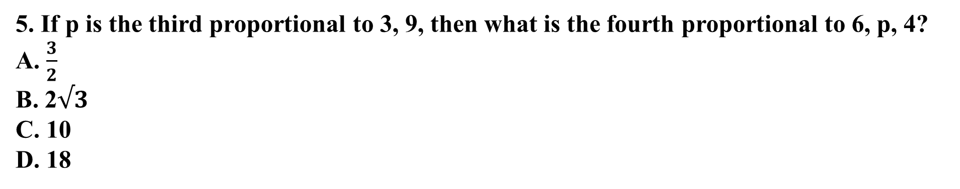
5. If p is the third proportional to 3, 9, then what is the fourth proportional to 6, p, 4?
A. $\frac{3}{2}$
B. 2$√3$
C. 10
D. 18
Notes:
Answer- D(Moderate)
Third proportional =$\frac{9X9}{3}$
Fourth proportional =$\frac{6}{27}$ = $\frac{4}{x}$
x = 18
17

Slide 18
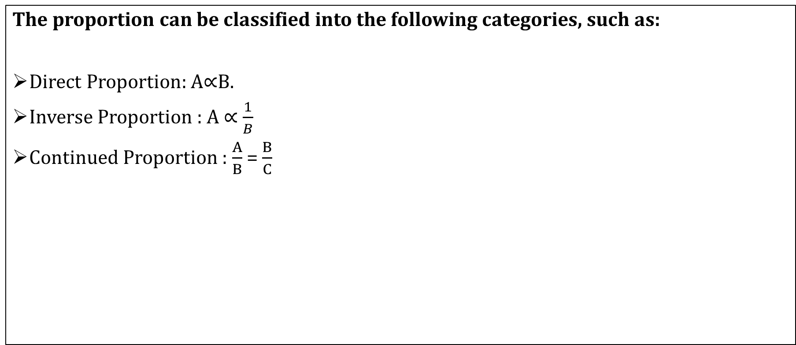
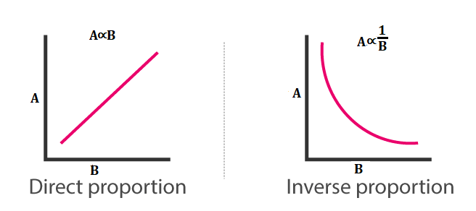
CLASSIFICATION OF PROPORTION

Slide 19
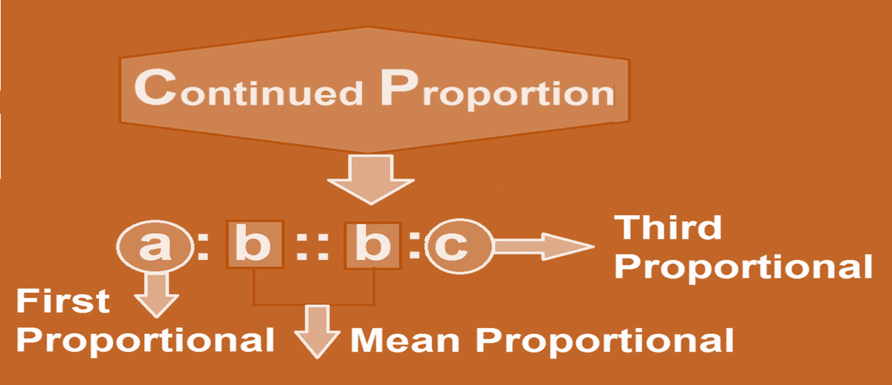

Slide 20
6. If x varies directly as y and x = 15 when y = 5, find x when y = 9.
18 B. 21
C. 27 D. 30
Notes:
Answer- C
20

Slide 21
7. If x varies inversely as y and x = 10 when y = 6, find y when x = 15.
2 B. 3
C. 4 D. 6
Notes:
Answer- C
21

Slide 22
8. If 0.75 : x :: 5 : 8, then x is equal to:
A. 1.12
B. 1.2
C. 1.25
D. 1.30
Notes:
Answer- B(Easy)
(X x 5) = (0.75 x 8) x =6= 1.20
22

Slide 23
9. If y/(x - z) = (y + x)/z = x/y then find z : y : x ?
A) 1:2:3
B) 3:2:4
C) 4:3:2
D) 2:3:4
Notes:
Answer: B) 3:2:4 (Easy) Explanation: Given, y/(x - z) = (y + x)/z = x/y yz = xy + x2 − yz − xz ..(1) Also x2 −xz = y2 ....(2) 2yz = xy + y2 2z = x + y Only option (B) satisfies the equation.
23

Slide 24
10. The sum of three numbers is 98. If the ratio of the first to second is 2 :3 and that of the second to the third is 5 : 8, then the second number is:
A. 20
B. 30
C. 48
D. 58
Notes:
Answe-B (Easy)
)Let the three parts be A, B, C. Then,
A : B = 2 : 3 and B : C = 5 : 8 =5 x3:8 x3= 3 :24555
A : B : C = 2 : 3 :24= 10 : 15 : 245
B =98 x15/49= 30
24

Slide 25
11.Two numbers are respectively 20% and 50% more than a third number. The ratio of the two numbers is:
A. 2 : 5
B. 3 : 5
C. 4 : 5
D. 6 : 7
Notes:
Answer-C (Easy)
Let the third number be x.
Then, first number = 120% of x =120x=6x100/5
Second number = 150% of x =150x=3x100/2
Ratio of first two numbers =6x :3x= 12x : 15x = 4 : 5
25

Slide 26
12.If 40% of a number is equal to two-third of another number, what is the ratio of first number to the second number?
A. 2 : 5
B. 3 : 7
C. 5 : 3
D. 7 : 3
Notes:
Answer- C (Easy)
Let 40% of A =⅔ of B
Then,40A=2B1003
2A=2B53
A=2x5=5B323
A : B = 5 : 3.
26

Slide 27
13. Rs. 2600 is divided into three parts A, B and C. How much A is more than C if their ratio is 1/2:1/3:1/4 ?
A) 600
B) 300
C) 150
D) 75
Notes:
Answer- A(Easy)
Explanation: 1/2:1/3:1/4 = 6:4:3
As the difference is 3
=> 3/13x2600 = 600
27

Slide 28
14. A sum of money is to be distributed among A, B, C, D in the proportion of 5 : 2 : 4 : 3. If C gets Rs. 1000 more than D, what is B's share?
A. Rs. 500
B. Rs. 1500
C. Rs. 2000
D. None of these
Notes:
Answer- B (Easy)
Let the shares of A, B, C and D be Rs. 5x, Rs. 2x, Rs. 4x and Rs. 3x respectively.
Then, 4x - 3x = 1000
x = 1000.
B's share = Rs. 2x = Rs. (2 x 1000) = Rs. 2000
28

Slide 29
15. A person divided Rs. 10800 among his three sons in the ratio 3 : 4 : 5. Second son kept Rs. 1000 for himself, gave Rs. 600 to his wife and divided the remaining money among his two daughters in the ratio 11 : 9. Then one of his daughters received.
(A) Rs. 1000
(B) Rs. 1050
(C) Rs. 1100
(D) Rs. 1150
Notes:
Ans: C (Expert)
Second son’s share = Rs. (10800×412) = Rs. 3600.
Money distributed between the two daughters
= Rs. [3600 – (1000 + 600)] = Rs. 2000.
First daughter’s share = Rs. (2000×11/20) = Rs. 1100.
Second daughter’s share = Rs. (2000×9/20) = Rs. 900.

Slide 30
16. The ratio of the number of boys and girls in a college is 7 : 8. If the percentage increase in the number of boys and girls be 20% and 10% respectively, what will be the new ratio?
A. 8 : 9
B.17 : 18
C. 21 : 22
D. Cannot be determined
Notes:
Answer-C (Easy)
Originally, let the number of boys and girls in the college be 7x and 8x respectively.
Their increased number is (120% of 7x) and (110% of 8x).
120x 7x /100 and 110x 8x/100
42x and 44x
The required ratio =42x:44x= 21 : 22
30

Slide 31
17. Seats for Mathematics, Physics and Biology in a school are in the ratio 5 : 7 : 8. There is a proposal to increase these seats by 40%, 50% and 75% respectively. What will be the ratio of increased seats?
A. 2 : 3 : 4
B. 6 : 7 : 8
C. 6 : 8 : 9
D. None of these
Notes:
Answer- A(Easy)
Originally, let the number of seats for Mathematics, Physics and Biology be 5x, 7x and 8x respectively.
Number of increased seats are (140% of 5x), (150% of 7x) and (175% of 8x).
7x,21x and 14x.2
The required ratio
14x : 21x : 28x
2 : 3 : 4.
31

Slide 32
18. Two number are in the ratio 3 : 5. If 9 is subtracted from each, the new numbers are in the ratio 12 : 23. The smaller number is:
A. 27
B. 33
C. 49
D. 55
Notes:
Answer- B (Easy)
Let the numbers be 3x and 5x.
Then,3x - 9=125x - 923
23(3x - 9) = 12(5x - 9)
9x = 99
x = 11.
The smaller number = (3 x 11) = 33.
32

Slide 33
19. Salaries of Ravi and Sumit are in the ratio 2 : 3. If the salary of each is increased by Rs. 4000, the new ratio becomes 40 : 57. What is Sumit's salary?
A. Rs. 17,000
B. Rs. 20,000
C. Rs. 25,500
D. Rs. 38,000
Notes:
Answer(D) (Moderate)
Let the original salaries of Ravi and Sumit be Rs. 2x and Rs. 3x respectively.
Then,2x + 4000=3x + 4000
57(2x + 4000) = 40(3x + 4000)
6x = 68,000
3x = 34,000
Sumit's present salary = (3x + 4000) = Rs.(34000 + 4000) = Rs. 38,000.
33

Slide 34
20. In a bag, there are coins of 25 p, 10 p and 5 p in the ratio of 1 : 2 : 3. If there is Rs. 30 in all, how many 5 p coins are there?
A. 50
B. 100
C. 150
D. 200
Notes:
Answer- C (Moderate)
Let the number of 25 p, 10 p and 5 p coins be x, 2x, 3x respectively.
Then, sum of their values = Rs.0.25x+0.10 x 2x+0.5 x 3x= Rs.0.60x
0.60x= 30 x =50
Hence, the number of 5 p coins = (3 x 50) = 150.
34

Slide 35
21. A box contains 280 coins of one-rupee, 50-paise and 25-paise. The values of each kind of the coins are in the ratio of 8:4:3. Then the number of 50-paise coins is.
A. 50
B. 80
C. 120
D. 200
Notes:
Answer- B (Moderate)
Rs 1 50p 25p
Value 8 4 3
No. of coins 8 8 12
Total no of coins=28
28 coins =280
1 coins = 10
No. of 50 paise coins = 8×10 =80 Ans.
35

Slide 36
22. One year ago the ratio between Maneela’s and Shanthi’s salary was 3 : 4. The ratios of their individual salaries between last year’s and this year’s salaries are 4 : 5 and 2 : 3 respectively. At present the total of their salary is Rs. 4160. The salary of Maneela, now is?
Rs. 1600
Rs. 1700
Rs. 1800
Rs. 1900
Notes:
Answer: A) Rs. 1600 (Moderate) Explanation: Let the salaries of Maneela and Shanthi one year before be M1, S1 & now be M2, S2 respectively.
Then, from the given data,
M1/S1 = 3/4 .....(1)
M1/M2 = 4/5 .....(2)
S1/S2 = 2/3 .....(3)
and M2 + S2 = 4160 .....(4)
Solving all these eqtns, we get M2 = Rs. 1600.
36

Slide 37

23. Three cats are roaming in a zoo in such a way that when cat A takes 5 steps, B takes 6 steps and C takes 7 steps. But the 6 steps of A are equal to the 7 steps of B and 8 steps of C. what is the ratio of their speeds?
A) 140:144:147
B) 40:44:47
C) 15:21:28
D) 252:245:240
Notes:
Answer: A) 140:144:147(Moderate) Explanation: Frequency of step of A:B:C = 5 : 6 : 7
But in terms of size of step, 6A = 7B = 8C
Therefore, Ratio of speeds of A, B and C = 5/6 : 6/7 : 7/8 = 140 : 144 : 147
37

Slide 38
24. 80 litres of diesel is required to travel 800 km using a 800 cc engine. If the volume of diesel required to cover a distance varies directly as the capacity of the engine, then how many litres of diesel is required to travel 1000 kms using 1200 cc engine ?
A) 120 lit
B) 140 lit
C) 110 lit
D) 150 lit
Notes:
Answer: D) 150 lit (Expert) Explanation: To cover a distance of 800 kms using a 800 cc engine, the amount of diesel required = 80 litres.
=> the amount of diesel required to cover a distance of 1000 kms = 1000 x 80/800 = 100 litres
However, the vehicle uses a 1200 cc engine and it is given that the amount of diesel required varies directly as the engine capacity.
i.e., for instance, if the capacity of engine doubles, the diesel requirement will double too.
Therefore, with a 1200 cc engine, quantity of diesel required = 1200/800 x 100 = 150 litres.
38

Slide 39
25. In a fort, there are 1200 soldiers. If each soldier consumes 3 kg per day, the provisions available in the fort will last for 30 days. If some more soldiers join, the provisions available will last for 25 days given each soldier consumes 2.5 kg per day. Find the number of soldiers joining the fort in that case ?
A) 693
B) 741
C) 528
D) 654
Notes:
Answer: C) 528 (Expert) Explanation: Assume x soldiers join the fort. 1200 soldiers have provision for 1200 (days for which provisions last them)(rate of consumption of each soldier) = (1200)(30)(3) kg.
Also provisions available for (1200 + x) soldiers is (1200 + x)(25)(2.5) k
As the same provisions are available => (1200)(30)(3) = (1200 + x)(25)(2.5)
x = ([(1200)(30)(3)] / (25)(2.5)) - 1200 => x = 528.
39

Slide 40
26. Maneela, Raghu and Aravind have some jems with each of them. Five times the number of jems with Raghu equals seven times the number of jems with Maneela while five times the number of jems with Maneela equals seven times the number of jems with Aravind. What is the minimum number of jems that can be there with all three of them put together ?
A) 108
B) 107
C) 109
D) 110
Notes:
Answer: C) 109 (Moderate) Explanation: From given data,
R : M = 5 : 7
M : A = 5 : 7
R : M : A = 25 : 35 : 49
25 + 35 + 49 = 109
40

Slide 41
27. There is certain numbers of toys in the box. They are divided into such a way that the person who gets 1/4 of the whole gets thrice of what the others get on an average. Find the number of people amongst whom the toys are distributed?
A) 8
B) 10
C) 12
D) 9
Notes:
Answer: B) 10(Moderate) Explanation: If the person who gets 1/4 of the whole gets thrice of what the others get on an average, each one will get =1/3×1/4=112 of the whole. Therefore, if there are k persons other than the person who gets one-fourth, then 1/4 + k/12 = 1 ⇒ k=9 Hence, total number of people = 10.
41

Slide 42
28. In Maa Yatri Temple every devotee offers fruits to the orphans. Thus every orphan receives bananas, oranges and grapes in the ratio of 3:2:7 in terms of dozens. But the weight of a grape is 24 gm and weight of a banana and an orange are in the ratio of 4:5, while the weight of an orange is 150gm. Find the ratio of all the three fruits in terms of weight, that an orphan gets
A) 90:75:42
B) 180:150:82
C) 75:42:90
D) None of these
Notes:
Answer: D) None of these (Expert) Explanation: Ratio of fruits (by dozen) = 3:2:7
Ratio of fruits (by weight) = 120 :150: 24
Therefore, Ratio of fruits (combined) by weight = 3 x 120 : 2 x 150 : 7 x 24 = 30 : 25 : 14
42

Slide 43
Thank you

